Slide 1
Authority, Order of Reading, and Authenticity in Two Manuscripts of the Logica Vetus
Jacob Archambault

Slide 2
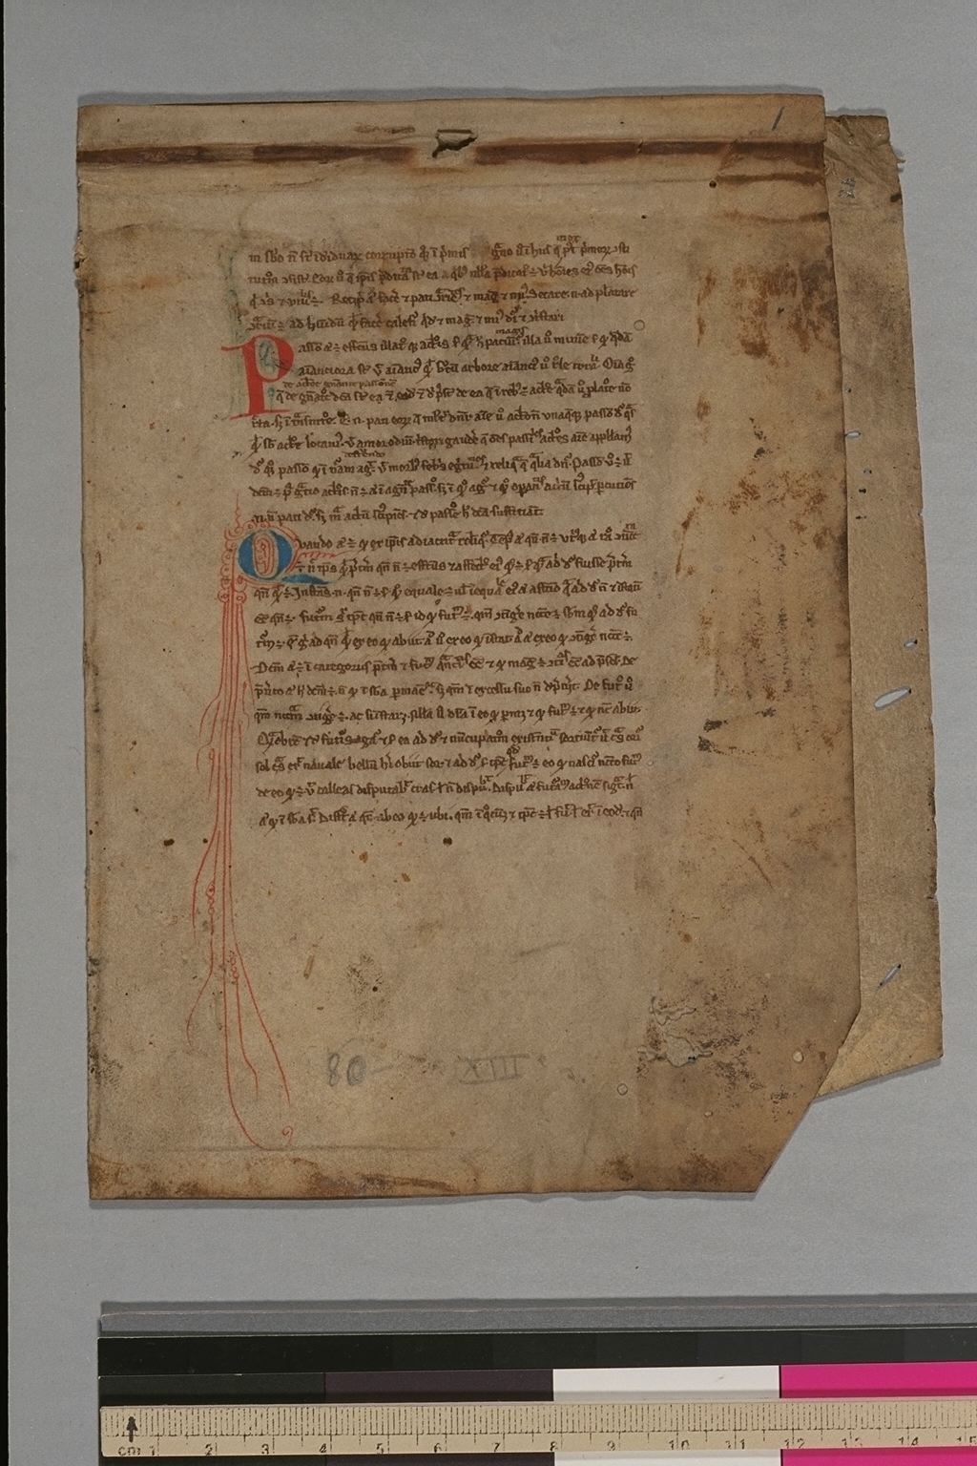
Smith Med/Ren Frag. 27 – What we currently know.
Parchment bifolium currently housed at Columbia University.
Small, rapid, heavily abbreviated, northern Gothic textualis script, likely written between 1255 and 1275 in Northern France
3 Initials – wo on recto 1, one on verso of 1.
Only about 25% of the parchment is devoted to the main text of the document itself (i.e. intended for glossing)
Very few little gloss.

Slide 3
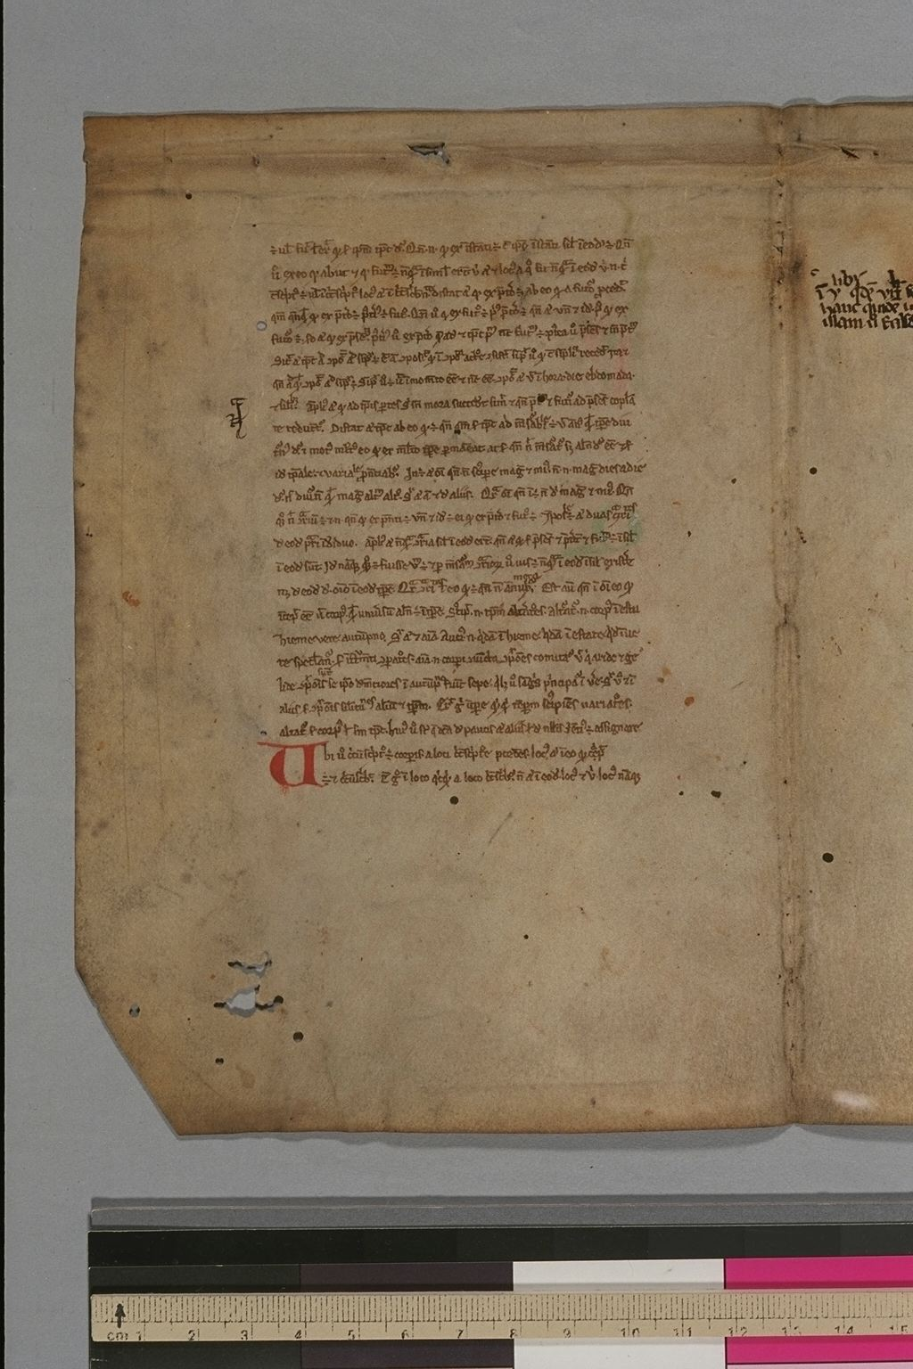
Smith Med/Ren frag. 27 – New Information
Folium 1 – Liber sex principiorum, II.27-V.48.
Folium 2 - Aristotle's Peri Hermeneias (trans. Boethius), 8f-9.
The liber sex principiorum survives in whole or in part in about 231 manuscripts, about 104 of which are of comparable or greater antiquity than Smith 27 itself.
The Boethian translation of the de interpretatione survives in 297 manuscripts stretching from the 9th c. to the end of the middle ages.

Slide 4
Introducing the Liber
Anonymous 12th c. work
Intended as a supplement to Aristotle’s Categories
In the Categories, Aristotle only treats the 1st four categories in detail: substance, quality, quantity, relation.
the Liber provides detailed descriptions of the remaining six: action, passion, time, place, position, and habit.

Slide 5
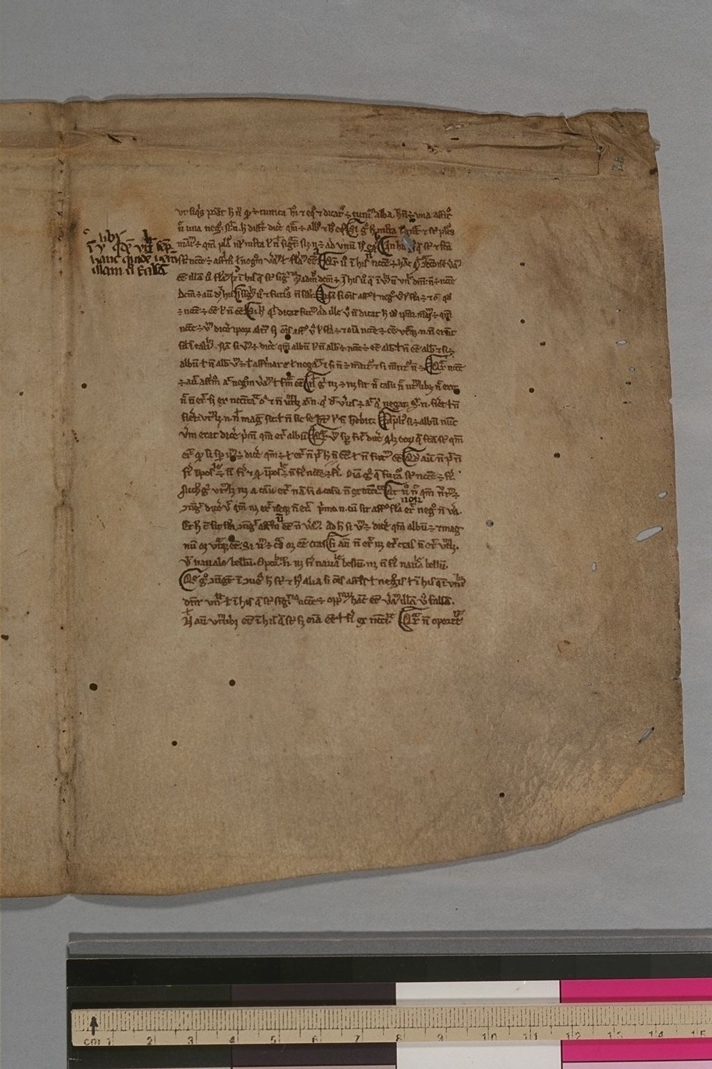
Aristotle’s Peri Hermeneias
Aristotle’s treatise on affirmative and negative statements
Ch. 8 – on the opposition of affirmative and negative statements
Ch. 9 – Future contingents

Slide 6
Situating Smith frag. 27 in its former codex
Assumptions
gap between Liber V and De interpretatione 8 is filled
there are no additional works between the two
the amount of text on each page is uniform

Slide 7
Situating Smith 27 in its former codex (cont.)
Smith 27 folium i: Contains Liber Sex Principiorum II.27-5.48 | Smith 27 Folium ii: contains De Interpretatione VIII.61-IX
Missing folium i: Contains Liber Sex Principiorum V. 49-VII. 70 | missing folium vi: contains De Interpretatione VI.39-VIII.60
Missing folium ii: contains Liber Sex Principiorum VII. 71-VIII.92 | Missing folium v: contains De Interpretatione III.17-VI.38
Missing folium iii: contains Liber Sex Principiorum VIII. 93 & explicit | Missing folium iv: De Interpretatione incipit, I.1-II.16

Slide 8
Situating Smith 27 in its former codex – possible candidates
Arras, Bib. Mun. 362
End of Peri Hermeneias Bk. I and beginning of Bk. II are missing
Text is about the right size
Problem: Texts aren’t in the right order.
Auch, Bib. Mun. 11
Paris, Bib. Nat. Lat. 16597*
Texts are in right order
Text/page ratio doesn’t match
Texts are in an Italian hand
Paris, Bib. Nat. Lat. 15088
Rheims, Bib. Mun. 870
Text/page ratio doesn’t match

Slide 9
Situating Smith 27 in its wider curriculum
Isagoge, 49
Categories, 48
Periermenias, 41 |  |  |  |  |  | Liber Sex Principiorum, 6
Liber Sex Principiorum, 28 |  |  | De Divisione, 4 | De Topicis Differentiis, 3 | Aristotle’s Topics, 2 | Periermenias, 5
De Divisione, 22 |  |  | De Topicis Differentiis, 4 |  | On Sophistical Refutations, 2 | De Divisione, 3
De Topicis Differentiis, 21 |  |  | Liber Sex Principiorum, 3 |  | Prior Analytics, 2 | De Topicis differentiis, 2
On Sophistical Refutations, 7 | Prior Analytics, 6 | Aristotle’s Topics, 5 | Prior Analytics, 2 |  | Posterior Analytics, 2
Aristotle’s Topics, 6 | Posterior Analytics, 6 | On Sophistical Refutations, 5
Prior Analytics, 5 | Aristotle’s Topics, 5 | Prior Analytics, 5
Posterior Analytics, 5 | On Sophistical Refutations, 5 | Posterior Analytics, 5

Slide 10
Authority and Order of Reading in the Logica Vetus
Greek Texts of the Logica Vetus | Latin Texts of the Logica Vetus | Logica Nova

